Slide 1
Overvejelser om exposure

Slide 2
Epidemiology:
The neglected half of pharmacoepidemiology
Pharmacology:
The neglected half of pharmacoepidemiology

Slide 3
Correctly classifying the subjects of a study in exposed or non-exposed constitutes the foundation of an epidemiologic study.
Since by definition, in a pharmacoepidemiological study the exposure is a drug, a sound knowledge of drug utilisation, pharmacology and toxicology are essential to the design and critical appraisal of these studies.

Slide 4
Farmakologi
Eksponering
Misklassifikationsbias
Adherence

Slide 5
Farmakologi

Slide 6
Medfører brug af tranexamsyre under hoftealloplastik... ballade?
Blødning?
Myokardieinfarkt?
Iskæmisk stroke?

Slide 7
Farmakologi

Slide 8
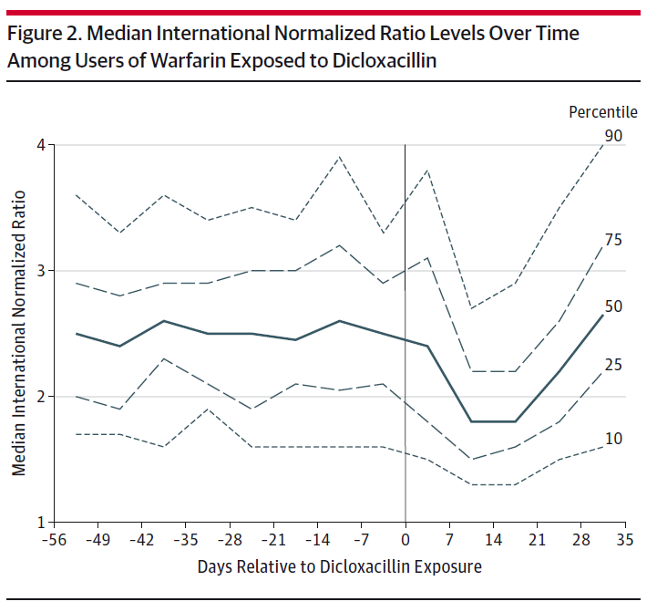
Farmakologi

Slide 9
Farmakologi

Slide 10
Farmakologi

Slide 11
Farmakologi

Slide 12
Eksponering

Slide 13
Eksponering
Ibuprofen 400 mg
Ibuprofen 400 mg
100 tablets
100 tablets
Upper GI bleeding
March 11
March 28
April 10

Slide 14
Eksponering
Ibuprofen 400 mg
Ibuprofen 400 mg
100 tablets
100 tablets
Upper GI bleeding
January 11
April 28
July 10

Slide 15
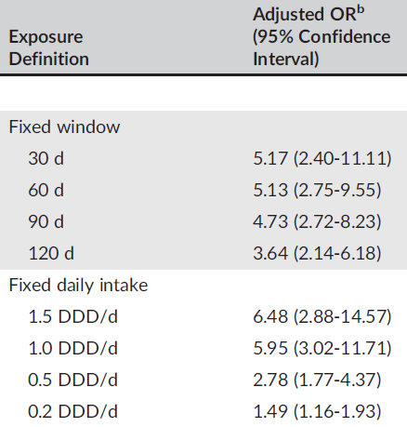
Eksponering
Hallas, Pottegård, and Støvring (PDS 2016)

Slide 16
En statin-tablet om dagen?
En SSRI-tablet om dagen?
En alendronat-tablet om ugen?
1-2 panodiler 3-4 gange dagligt?

Slide 17
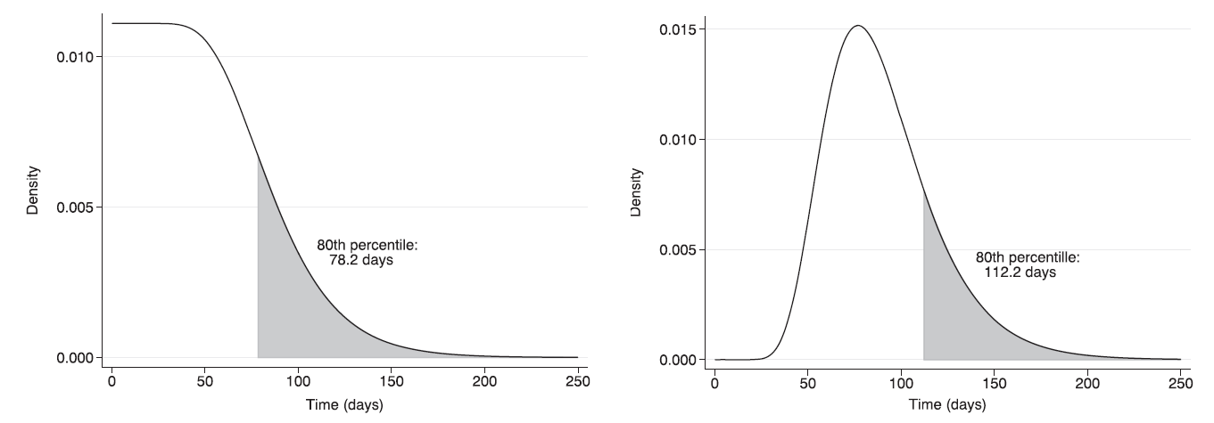
Drug | Parametric WTD
NSAID | 116
Warfarin | 91
Bendroflumethiazide | 137
Levothyroxine | 118
Støvring, Pottegård, and Hallas (PDS 2016)

Slide 18
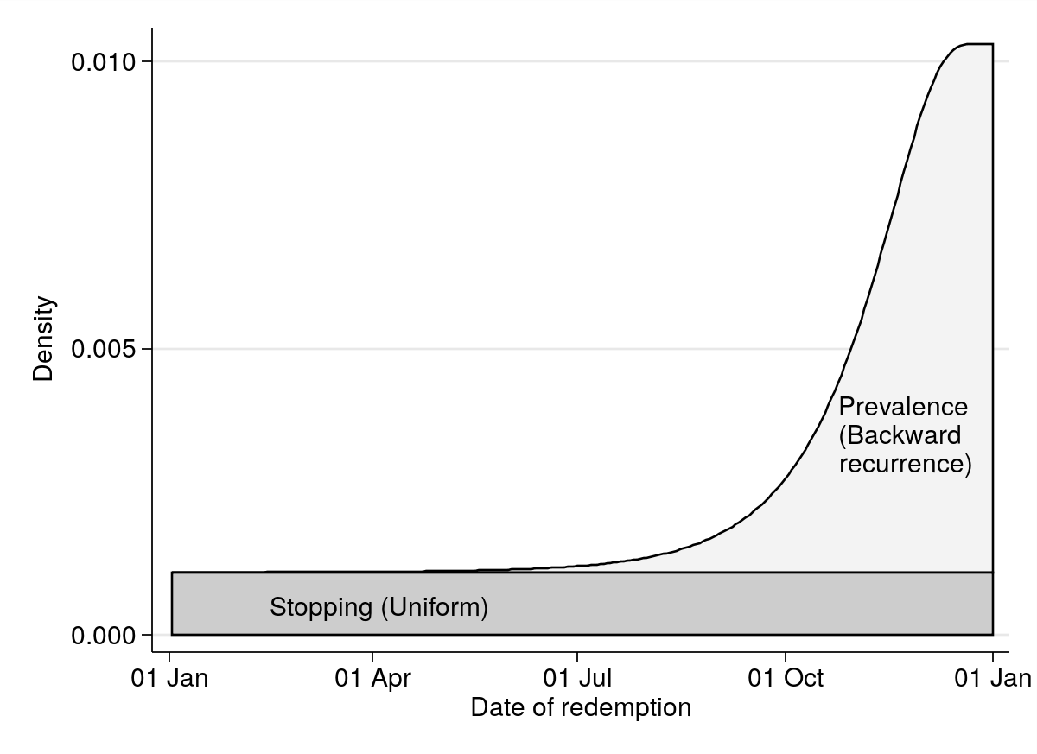
Sex | Age | 100 pills | 200 pills | 300 pills
Male | 50 | 62.7 | 90.2 | 125.2
Male | 70 | 78.1 | 112.9 | 157.1
Female | 50 | 65.4 | 92.2 | 126.5
Female | 70 | 81.2 | 117.3 | 163.1

Slide 19
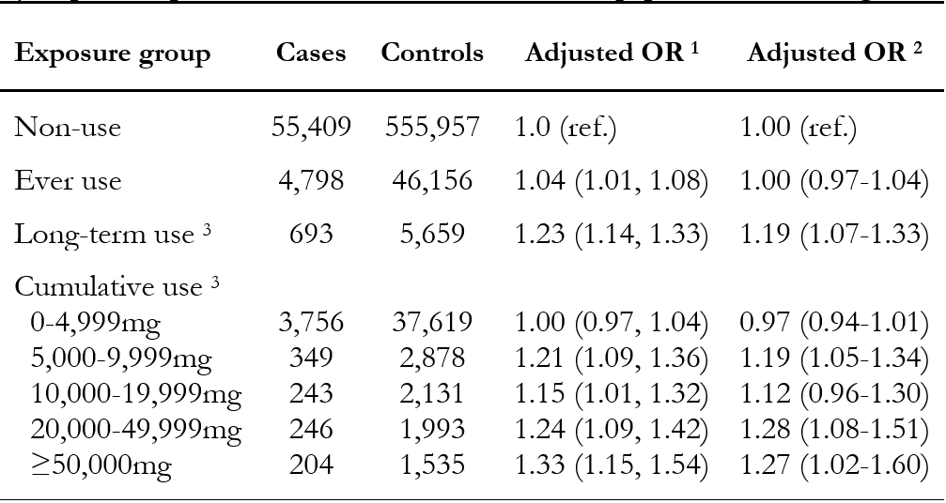
Eksponering

Slide 20
Eksponering

Slide 21
Misklassifikation

Slide 22
Misklassifikation
Hvad er højdeforskellen
mellem mænd og kvinder?

Slide 23
Misklassifikation

Slide 24
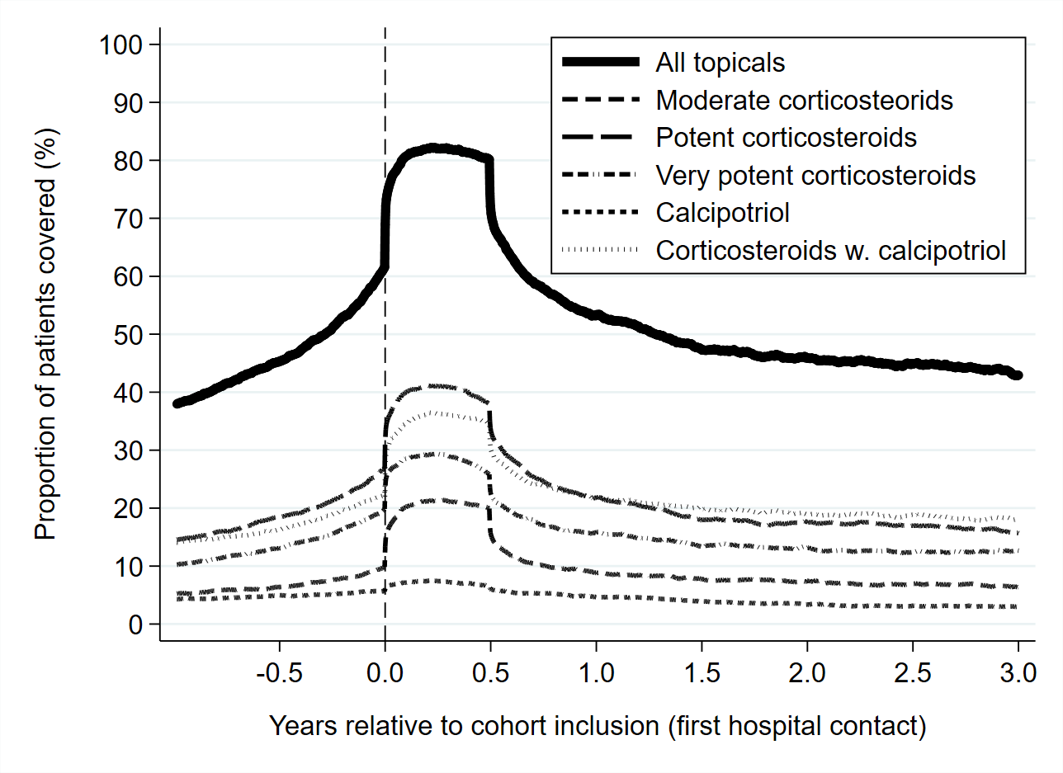
Adherence

Slide 25
Pharmacology:
The neglected half of pharmacoepidemiology

