Slide 1
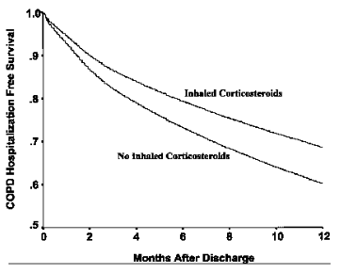

Slide 2
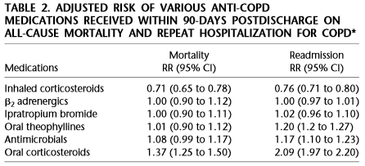

Slide 3
We used a longitudinal cohort design. We defined the index hospitalization date as the patient’s first admission to an acute care hospital with a diagnosis of COPD. The index discharge date was defined as the date on which patients were discharged. The beginning of patient observation time was defined as the date of discharge. The end of patient observation time was defined as the first repeat hospitalization for COPD, all-cause mortality, 365 d after discharge from the index admission, or the end of the study period (March 31, 1998), whichever was earliest.

Slide 4
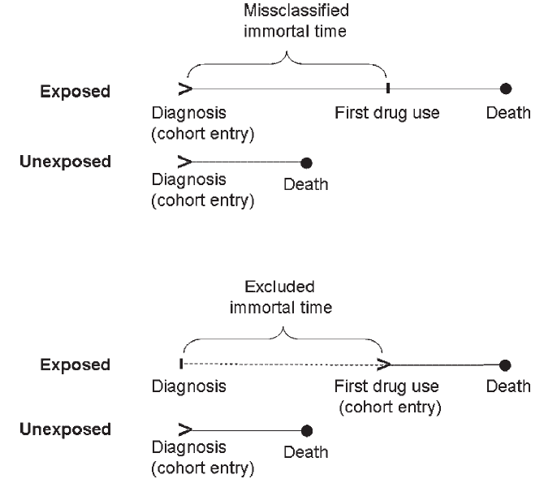

Slide 5
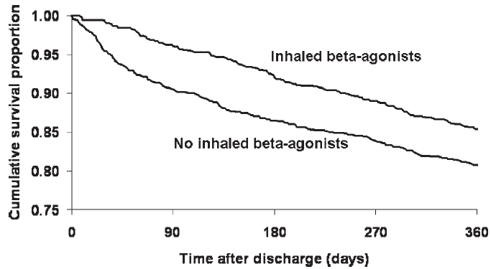

Slide 6
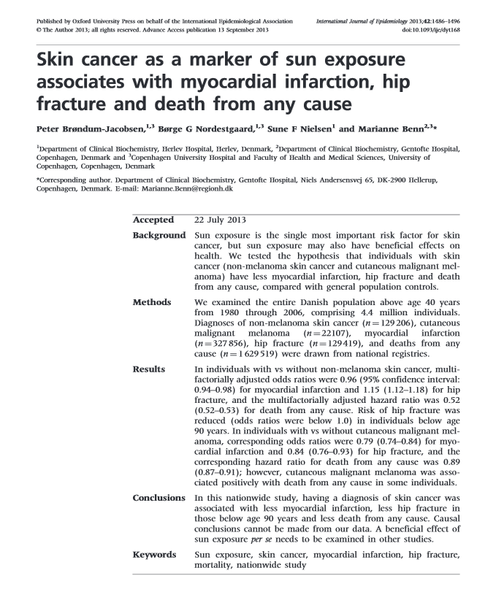

Slide 8
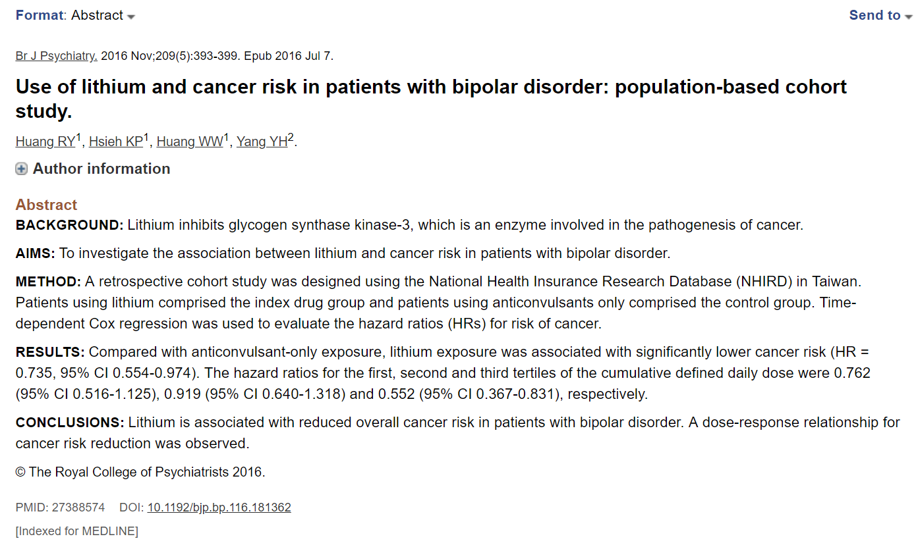

Slide 9
METHOD:
A retrospective cohort study was designed using the National Health Insurance Research Database (NHIRD) in Taiwan. Patients using lithium comprised the index drug group and patients using anticonvulsants only comprised the control group. Time-dependent Cox regression was used to evaluate the hazard ratios (HRs) for risk of cancer.

Slide 10
Immortal-time bias
Altid i kohortestudier
Når signalet er for godt til at være sandt
Når effekten indtræder for hurtigt
Man har brugt en krystalugle
Når ”grupper” frem for ”status” bliver analyseret

