Slide 1
Danish Prescription Registries
Anton Pottegård
Pharmacist, PhD
Clinical Pharmacology
University of Southern Denmark

Slide 3
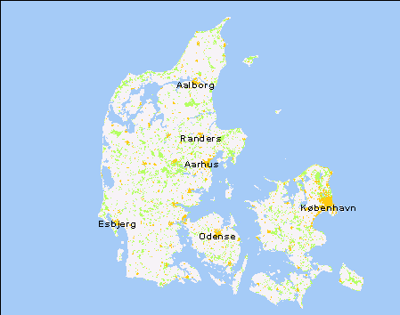

Slide 4
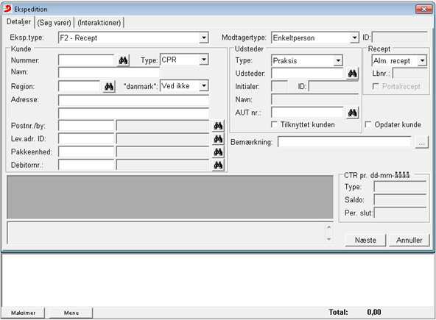

Slide 5
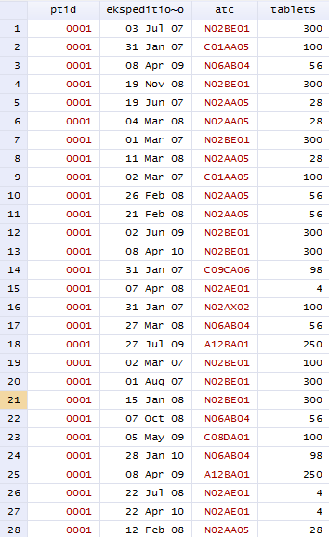

Slide 6
Regional vs National
Regional
Only subsidised drugs
Regional coverage
1990 onwards
Data can be transferred to other researchers
National
All prescription drugs
National coverage
1995 onwards
Closed circuit in Statistics Denmark

Slide 7
Some limitations
Delay in transfer of data
Indication in free text
Dose instruction in free text
Incomplete capture of magistral preparations
No capture of hospital dispensed medication
No capture of over-the-counter dispensings

Slide 8
Some strengths
World’s oldest NATIONAL individual level prescription database
Covers nursing homes (since 1999)

Slide 9
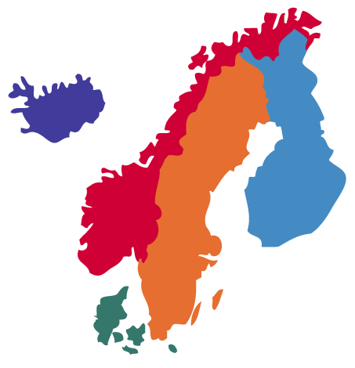

Slide 10
 | Basic registration | Prescriptions | Diagnoses (hospital) | Cancer
Denmark | 1968 | 1995 | 1977 | 1943
Finland | 1967 | 1994 | 1967 | 1953
Norway | 1964 | 2004 | 2008 | 1951
Sweden | 1965 | 2005 | 1987 | 1958

Slide 11
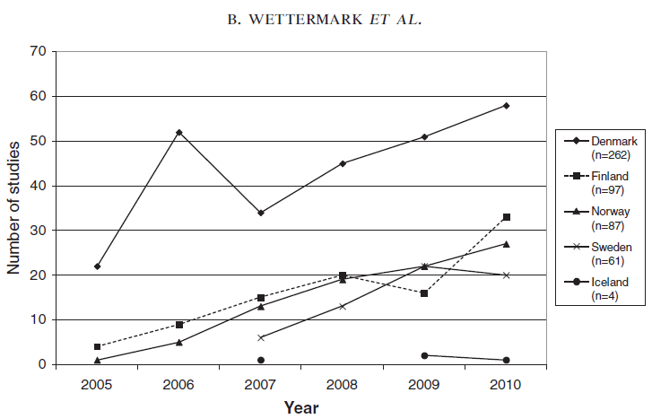
Wettermark et al. Pharmacoepidemiol Drug Saf 2014

