Slide 1
Estimation of causal effects in pharmacoepidemiology
Klaus Kaae Andersen
May 3, 2019

Slide 2
What’s the point?
Estimation of causal effects in pharmacoepidemiology is not possible, unless data comes from a trial
Measured
Confounders
Exposure
Outcome

Slide 3
We still try to do as good as we can
Estimation of causal effects in pharmacoepidemiology is not possible when having observational data
Still, we try to mimic a trial by applying different statistical techniques

Slide 4
Some options
Sibling designs
Instrumental variables
E-value
G methods
Analysis with missing data
Resampling methods
Cross-validation

Slide 5
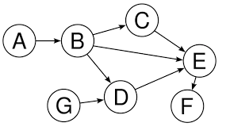
Validity
Internal validity refers to how well an experiment is done depends on whether we have
Selection bias
Information bias
Confounding
External validity depends on
Internal validity
External validity is the validity of applying the conclusions of a scientific study outside the context of that study. In other words, it is the extent to which the results of a study can be generalized to and across other situations, people, stimuli, and times.
$${g(Y}_{i})=a+b1{f1(x}_{i})+..+b{nfn(x}_{i})+ε_{i}$$
Weighted analysis, i.e. applying weights in the regression model

Slide 6
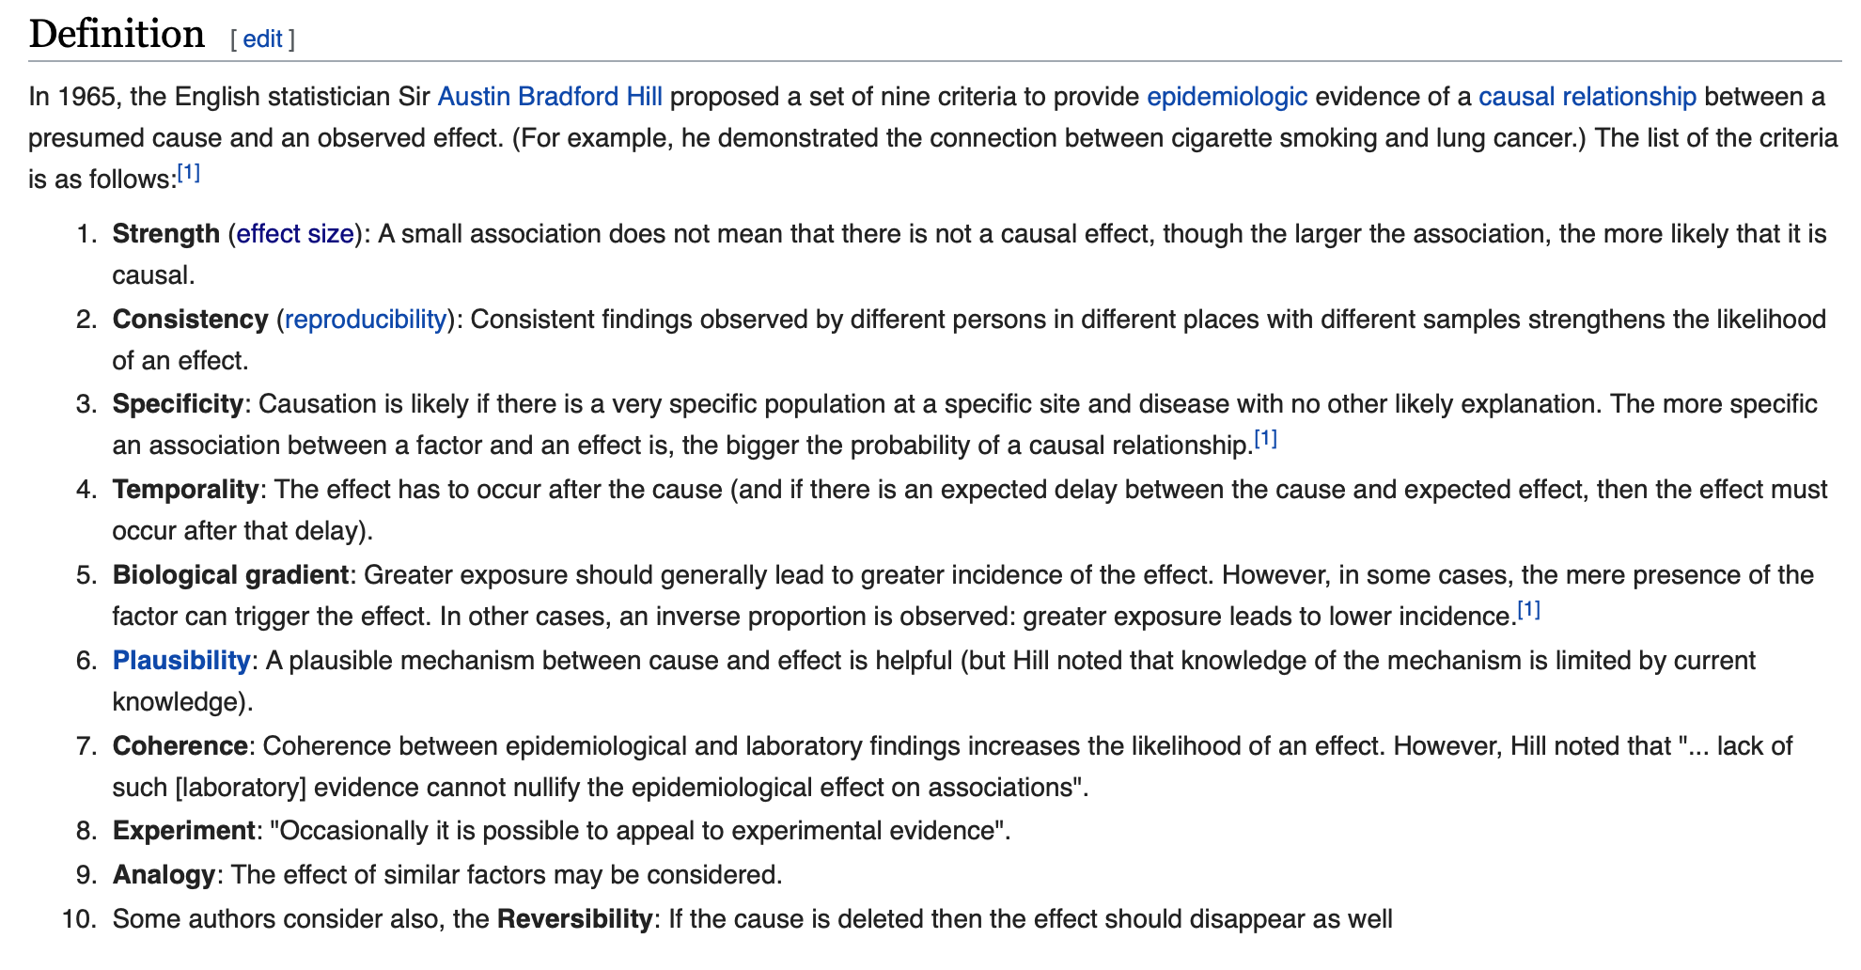

Slide 7
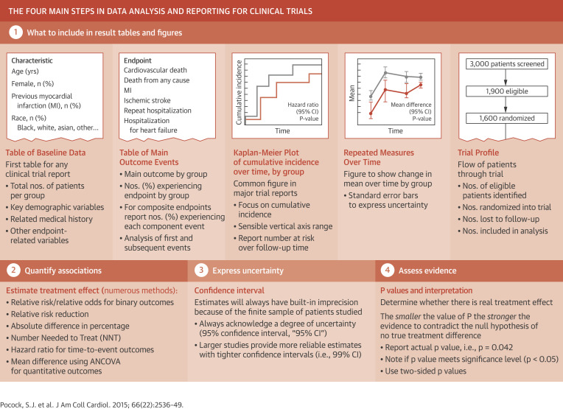
Reporting

Slide 8
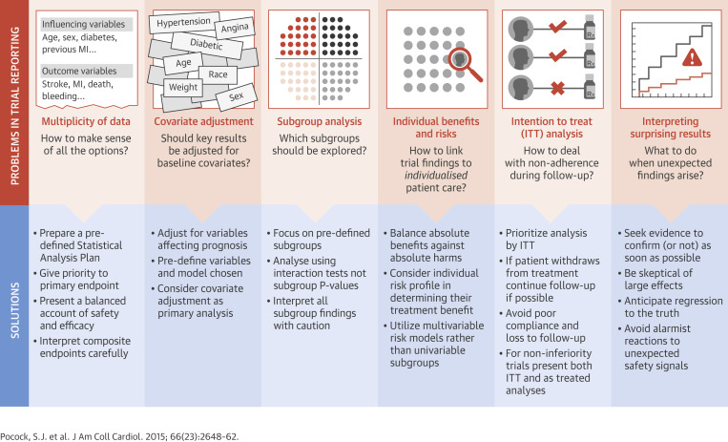
Challenges

Slide 9
Sibling designs

Slide 11
Instrumental variables

Slide 14
Sensitivity Analysis in Observational Research: Introducing the E-Value (VanderWeele and Ding, Annals of Internal Medicine)
Sensitivity analysis is useful in assessing how robust an association is to potential unmeasured or uncontrolled confounding.
The article introduces a new measure called the “E-value,” which is related to the evidence for causality in observational studies that are potentially subject to confounding.
The E-value is defined as the minimum strength of association, on the risk ratio scale, that an unmeasured confounder would need to have with both the treatment and the outcome to fully explain away a specific treatment–outcome association, conditional on the measured covariates.
A large E-value implies that considerable unmeasured confounding would be needed to explain away an effect estimate.
A small E-value implies little unmeasured confounding would be needed to explain away an effect estimate.

Slide 15
Why use the E-value
The authors propose that in all observational studies intended to produce evidence for causality, the E-value be reported or some other sensitivity analysis be used.
They suggest calculating the E-value for both the observed association estimate (after adjustments for measured confounders) and the limit of the confidence interval closest to the null.
If this were to become standard practice, the ability of the scientific community to assess evidence from observational studies would improve considerably, and ultimately, science would be strengthened.

Slide 16
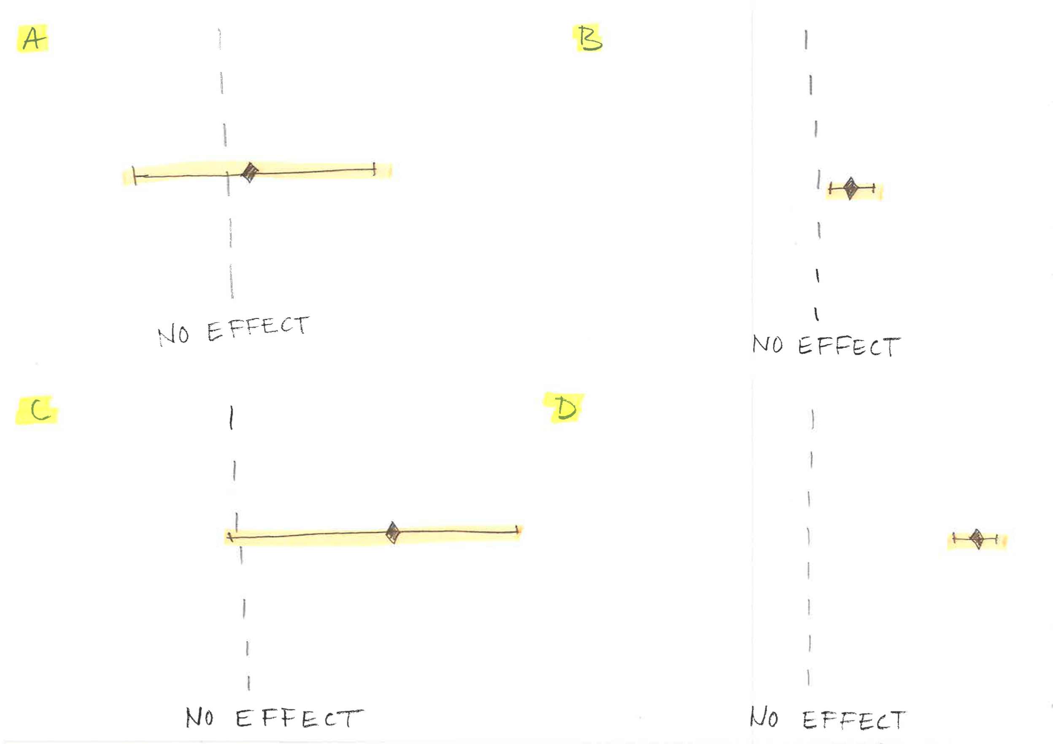

Slide 18
Calculation of the E-value
The E-value for an estimate, and for the limit of a 95% CI closest to the null, can be calculated in a straightforward way for risk ratios (Table 1) and for other measures (Table 2).

Slide 22
G-estimation
G-estimation (as proposed by Robins) is a method to estimate the effect of a time-varying exposure on survival time, allowing for time-varying confounders.

Slide 23
Weighted analysis
When conducting a survey, having a representative sample of the population is of paramount importance.
But in practice, you are prone to oversample some kinds of people and under-sample others.
Weighting is a statistical technique to compensate for this type of 'sampling bias'. A weight is assigned to:
Take into account the characteristics of sampling design
Reduce bias arising from nonresponse when the characteristics of the respondents differ from those not responding;
Correct identifiable deviations from population characteristics

Slide 25
Analysis of (with) missing data
Types of missing data
Describing patterns of missing data
Techniques of dealing with missing data
Model based techniques

Slide 26
Types of missing data
Missing completely at random (MCAR)
Missing at random (MAR)
Missing not at random (nonignorable)
Structurally missing data

Slide 27
Resampling methods (bootstrap)
Bootstrapping is a statistical method for estimating the sampling distribution of an estimator by sampling with replacement from the original sample, most often with the purpose of deriving robust estimates of standard errors and confidence intervals of a population parameter like a mean, median, proportion, odds ratio, correlation coefficient or regression coefficient.
It may also be used for constructing hypothesis tests. It is often used as a robust alternative to inference based on parametric assumptions when those assumptions are in doubt, or where parametric inference is impossible or requires very complicated formulas for the calculation of standard errors.

Slide 28
Bootstrap methods
Problems that are sometimes too difficult to analyze using parametric models can be answered (numerically) and non-parametric using bootstrap methods.

Slide 29
Cross validation
Cross-validation is a statistical method for validating a predictive model. Subsets of the data are held out for use as validating sets; a model is fit to the remaining data (a training set) and used to predict for the validation set. Averaging the quality of the predictions across the validation sets yields an overall measure of prediction accuracy.

Slide 30
New-user and prevalent-user designs
Klaus Kaae Andersen, 3/5 2019

