Slide 1
Case-control studies
Anton Pottegård
Associate professor, Clinical Pharmacology and Pharmacy, University of Southern Denmark
Head of Research, Funen Hospital Pharmacy, Odense University Hospital
apottegaard@health.sdu.dk
Twitter: @Pottegard

Slide 2
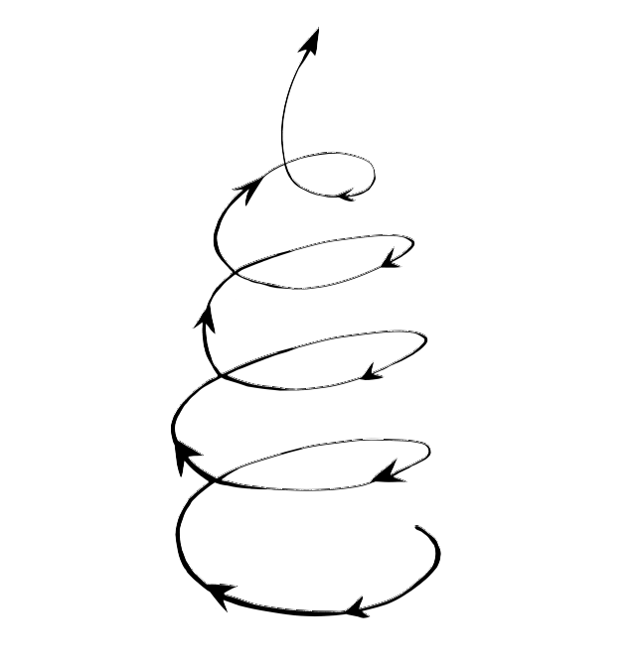

Slide 3
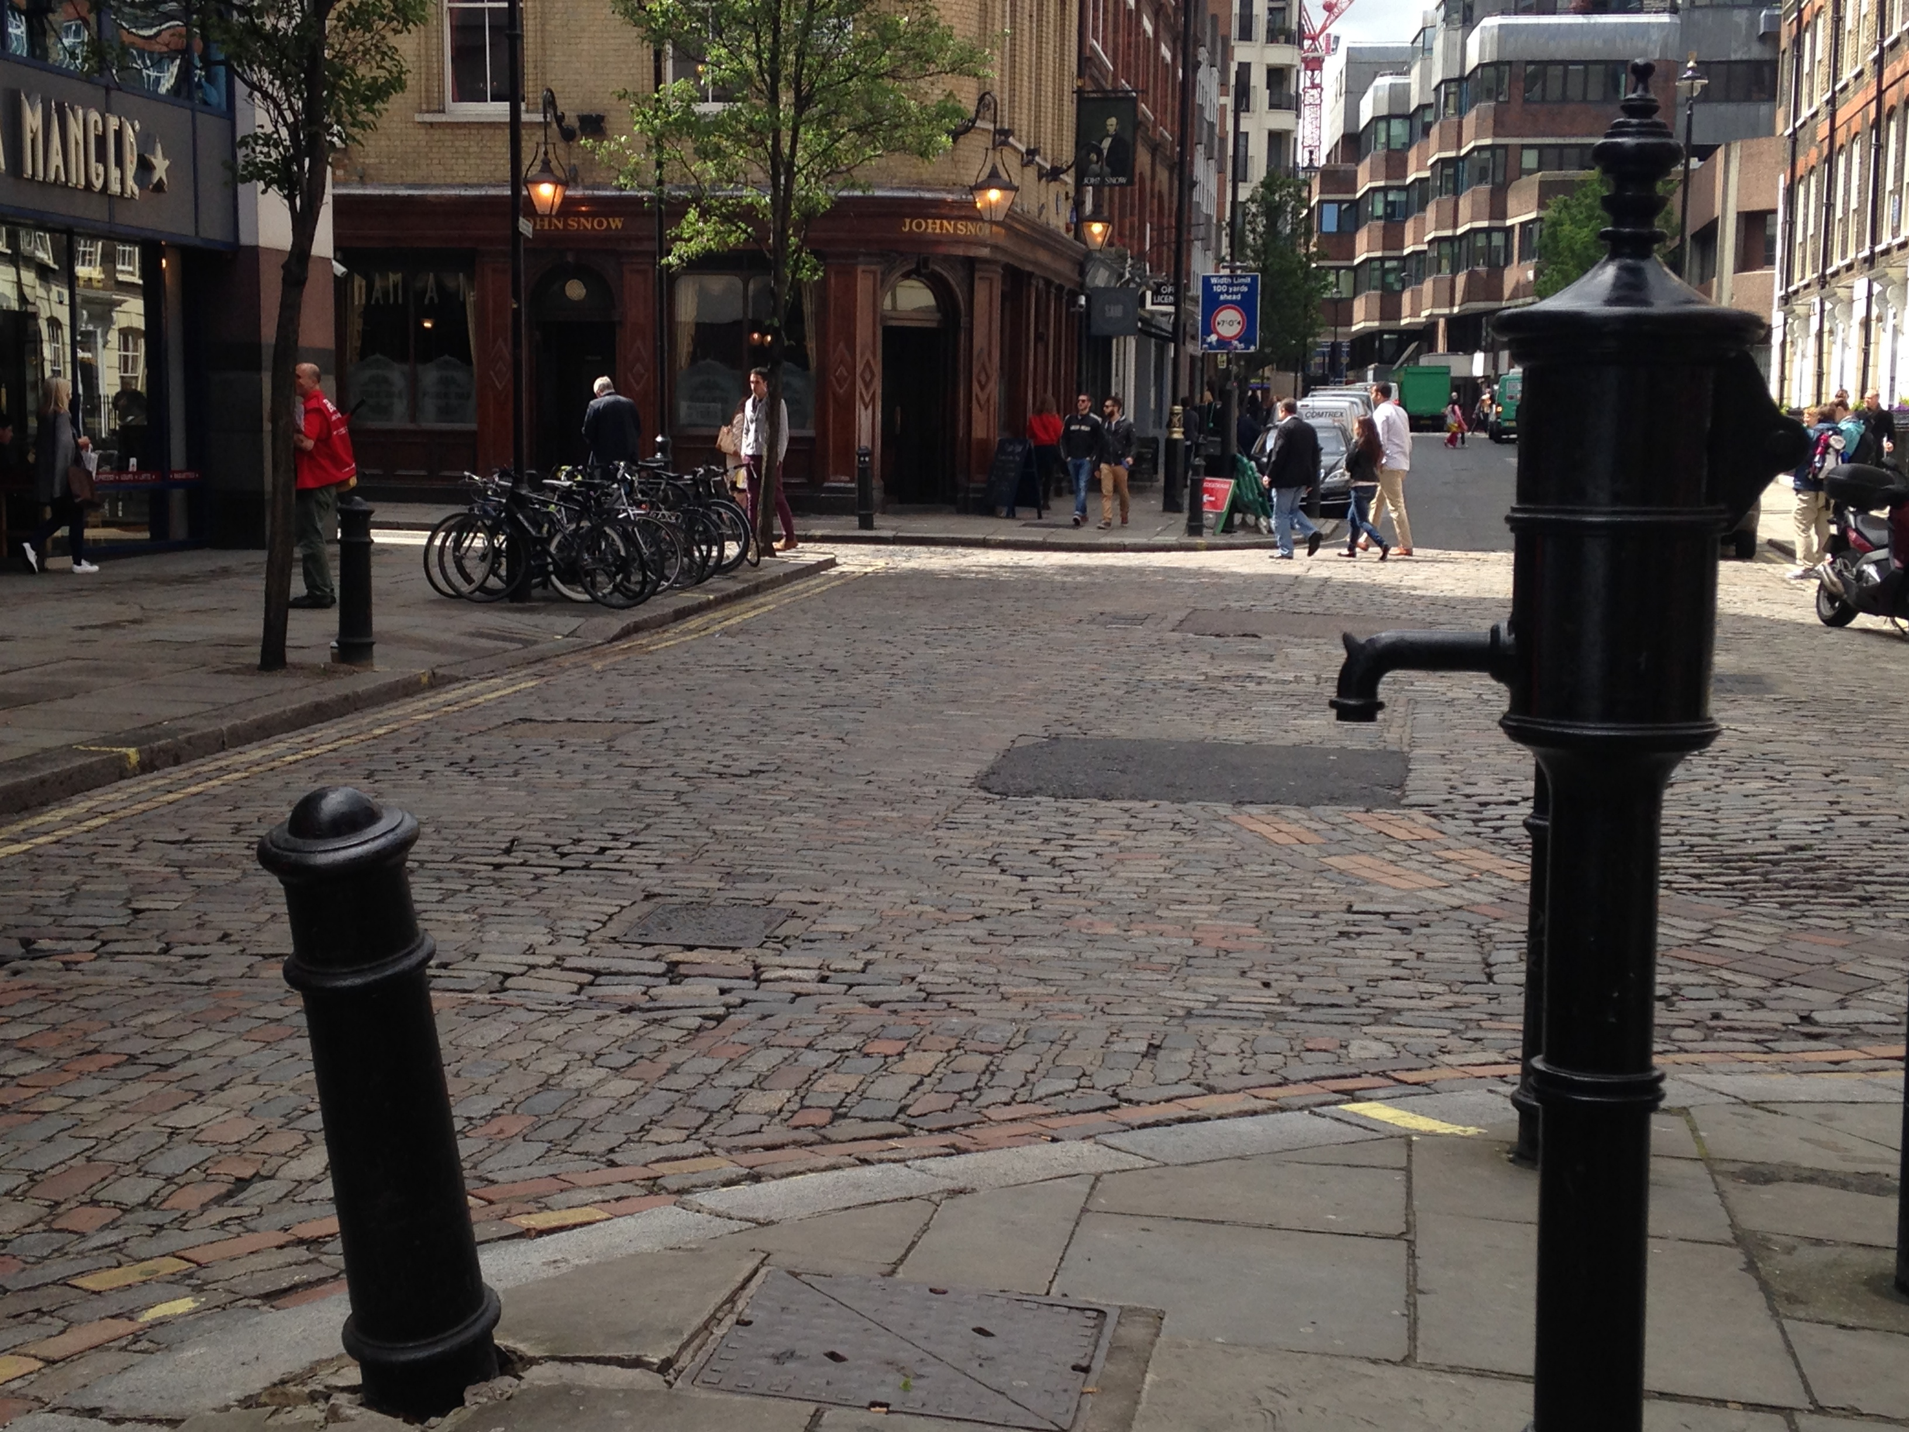
Notes:
Cholera outbreak in London
1850

Slide 4
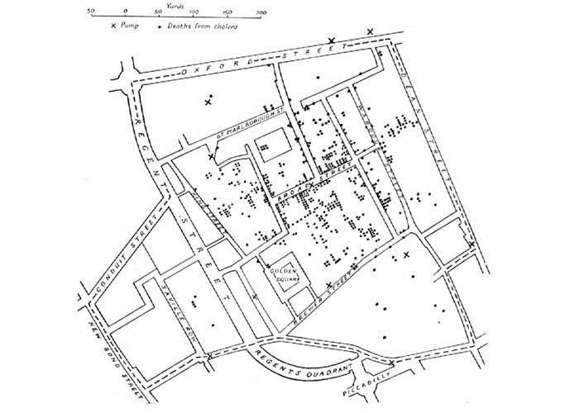
“On proceeding to the spot, I found that nearly all the deaths had taken place within a short distance of the [Broad Street] pump. There were only ten deaths in houses situated decidedly nearer to another street-pump.”
John Snow
(the one that actually knew something…)
Notes:
And of those 10, 5 actually used the pump and another 3 were children attending a school near the pump.
The handle was removed.

Slide 5
Cohort study
A group of subjects using the drug under scrutiny and a group of non-users are followed over time with respect to the development of a certain outcome.
Case-control study
Subjects with a certain outcome (cases) and subjects without this outcome (controls) are mapped according to use of the drug under scrutiny.

Slide 6
Cohort study
10,000 girls aged 20-25 years using ‘the pill’ are followed for three years.
Among these girls, 200 incident cases of deep vein thrombosis are recorded.
Among 20,000 girls NOT using ‘the pill’ (but same age and follow-up), 100 incident cases of deep vein thrombosis are recorded.
What is the incidence rate ratio?

Slide 7
Case-control study
300 girls aged 20-25 with incident deep vein thrombosis are identified. Among these girls, 80% had used ‘the pill’
Another 300 girls of the same age that have no record of deep vein thrombosis are identified. Among these girls, 50% have used ‘the pill’.

Slide 8
Odds ratio
 | DVT Y | DVT N
The pill Y | 240 | 150
The pill N | 60 | 150
$$OR= \frac{\left({240}/{60}\right)}{\left({150}/{150}\right)}=4$$

Slide 9
The difficult part…
Notes:
First cohort vs case-control
Then the difficult part, the underlying theory!
Then an example to get us back to earth.
Then the nitty gritty details (that is, the FUN part)
Strenghts and limitations to the CC
A quick dip into the self-controlled designs

Slide 10
Cohort design

Slide 11
Case-control design

Slide 12
Case-control design
Notes:
Controls = expo distr i background pop

Slide 13
Has it always been like this?
NO!

Slide 14
“Traditional” or Case-Non-Case or Cumulative Case-Control Studies
Persons
Use cases and a random sample of non-cases (controls)
Notes:
5/2/2019
Sonia Hernández-Díaz
14

Slide 15
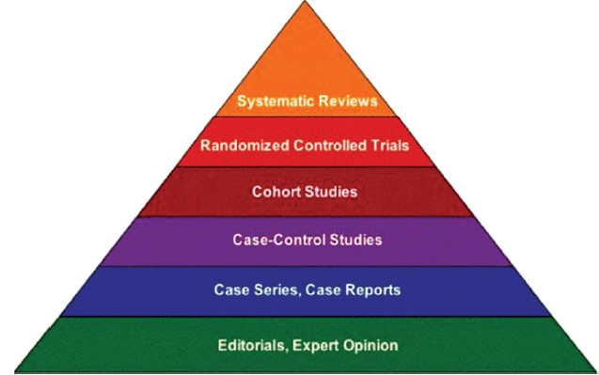
Evidence?!

