Slide 1
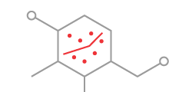
Study designs commonly used
in pharmaco-epidemiology
Christian Dehlendorff
Statistics and Pharmacoepidemiology
Danish Cancer Society Research Center
Notes:
Intro

Slide 2
Outline
Randomized controlled trial
Cohort studies (prognosis)
Nested case-control studies (risk)
Other designs

Slide 3
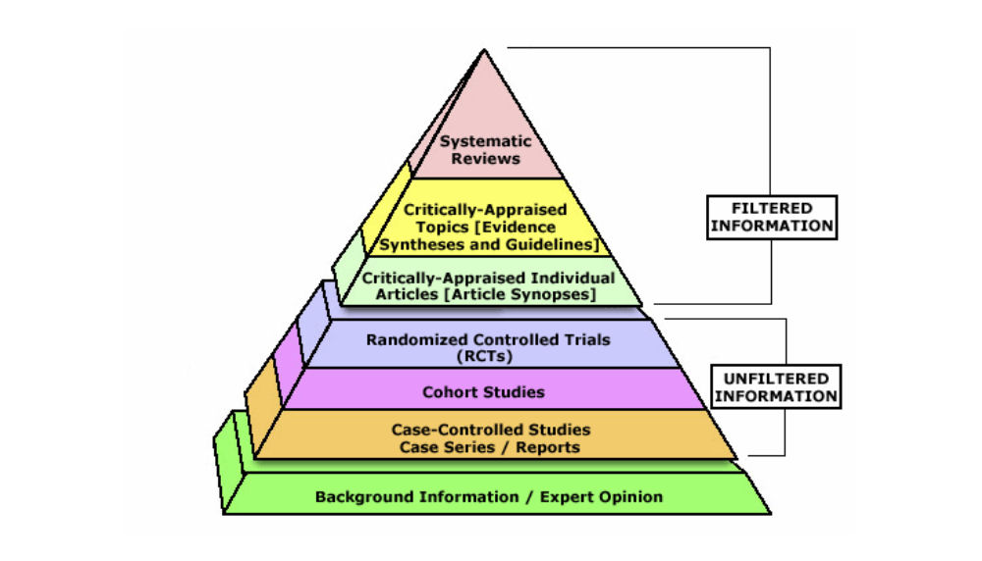
Randomized controlled trial

Slide 4
Randomized controlled trial
(Instrumental variable)
Treatment
Outcome
Randomization
Placebo

Slide 5
Randomized controlled trial
Benefits
  Treatment allocation randomized and controlled
    Treatment allocation independent of patient characteristics and outcome (exchangeable)
    “No confounding”
  Interpretation is causal (if quality of the study is sufficiently high)

Slide 6
Randomized controlled trial
Drawbacks
  Expensive
  Not always possible (unethical) – adverse events
  May be confined to a selected population
  Rare events difficult to study (e.g. aspirin and risk of cancer)
  Drop-outs, drop-ins, loss to follow-up etc. is a challenge

Slide 7
Cohort study

Slide 8
Cohorts
A group of people with something in common, e.g.
  an exposure
  a defined population group
    Occupational group
    A birth cohort
    Childhood cancer survivors
    A country…
Followed forward in time

Slide 9
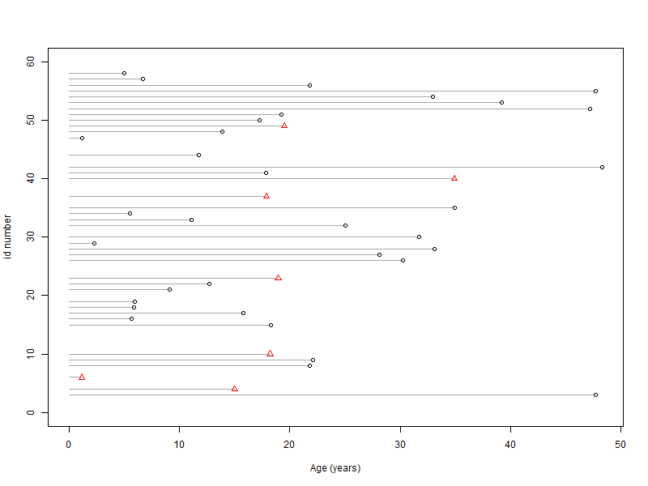
Cohort study

Slide 10
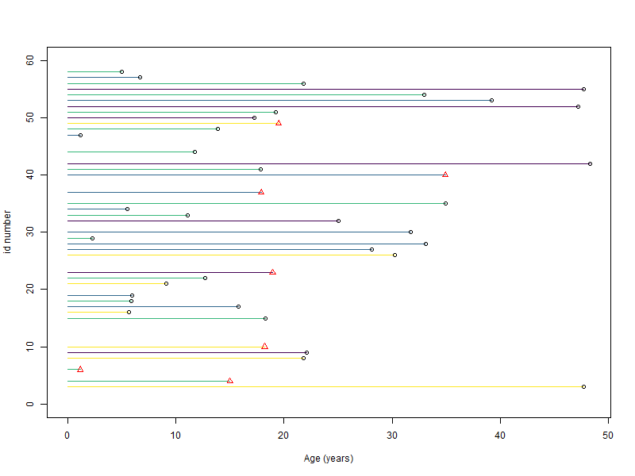
Cohort study

Slide 11
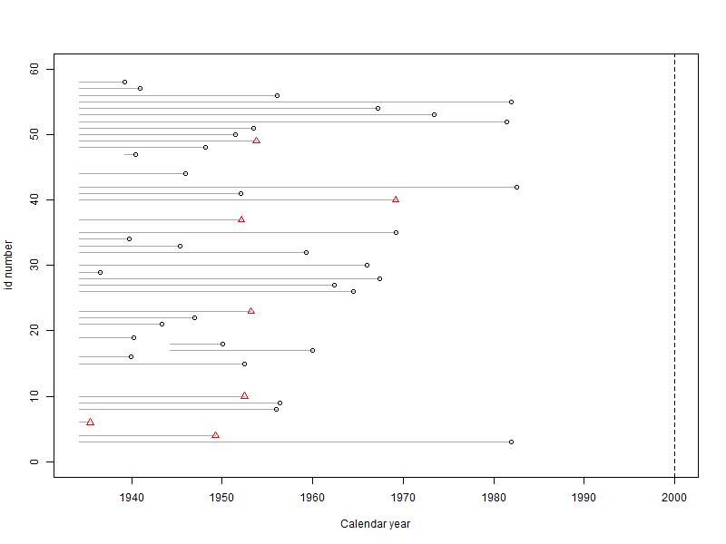
Historical cohorts
The cohort is constructed from registries
  Exposure, outcome and confounders
Sometimes called retrospective cohorts
We have all the information about exposure etc. up front
  Definitions and analyses need to comply with the cohort approach, i.e. as if we did not have all the information (e.g. not using future information)

Slide 12
Randomized controlled trial vs. cohort study
Intervention
Outcome
Randomization

Slide 13
Randomized controlled trial vs. cohort study
Exposure
Outcome
Confounders

Slide 14
Randomized controlled trial vs. cohort study
Disulfiram
Cancer
Randomization

Slide 15
Randomized controlled trial vs. cohort study
Disulfiram
Cancer
Confounding by indication!
Alcohol abuse

Slide 16
Randomized controlled trial vs. cohort study
 | RCT | Cohort
Exposure | Randomized | Observed
Costs | Expensive | Cheaper
Confounding | Minimal | "Always"
Population | Typically selected* | Less selected
* E.g. Knudsen et al., Diabetes Care, 2018

Slide 17
Things to consider
  Why do we want to do the study?
  How would the corresponding trial look like?
  Which population is relevant to study?
  What is the outcome? How do we define it?
  What is the exposure? How do we measure it?

Slide 18
Which population
  Entire population
  A particular subgroup
    Restricted on sex or age
    Some disease (e.g. cancer)
    Users of a particular class of drugs (active comparator study – e.g. studying different antihistamines)

Slide 19
Definition of exposure
  Typically based on registry data (or other databases)
  Prescription registry
    Dates for filled prescriptions
    Amount & type
  Two primary approaches
    Time-fixed
    Time-varying

Slide 20
Time fixed exposure
Use/Non-use
Amount
Type etc.
Exposure window
Death
Cancer
Start of FU

Slide 21
Time-varying exposure
Death

Slide 22
Time-varying exposure
Death

Slide 23
What you shouldn’t do
Death

Slide 24
Immortal time bias – Example
Suissa & Azoulay, 2012

Slide 25
Other types of exposures
  Cancer diagnosis
  Diabetes
  Surgical procedure
  Traffic noise
  Losing a child
  Etc.

Slide 26
Other issues when defining exposures
  Consider using a lag period?
Pottegård & Hallas, Pharmacoepidemiology and drug safety, 2017

Slide 27
Outcome
The condition we want to measure
  Needs to be clearly defined
Examples: Diagnosis in NPR, redeeming a prescription, cause-specific mortality (e.g. dying from your cancer)
The quality of the study depends on the precision/validity of the outcome definition (sometimes it is a proxy, e.g. diagnosis in NPR)

Slide 28
Competing events
Independent censoring vs. competing events
Cancer
Aspirin
Aalen-Johansen estimator
Cause specific hazards for all events
Death
Cardio-vascular disease

Slide 29
Competing events
Inherently a problem in Pharmacoepidemiology
  drugs typically taken for a reason (indication)
  Indication may e.g. be associated with competing event (aspirin and CVD)
  Makes interpretation more complicated!

Slide 30
Time-scale

Slide 31
Time-scale

Slide 32
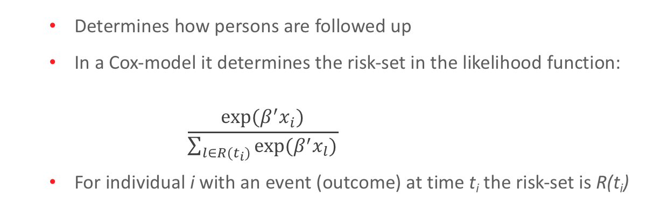
Why is the time-scale important?
  Determines how persons are followed up
  In a Cox-model it determines the risk-set in the likelihood function:
      $$\frac{exp⁡(β^{′}x_{i})}{\sum_{l∈R(t_{i})}{exp⁡(β^{′}x_{l})}}$$
  For individual i with an event (outcome) at time t_{i} the risk-set is R(t_{i})

Slide 33
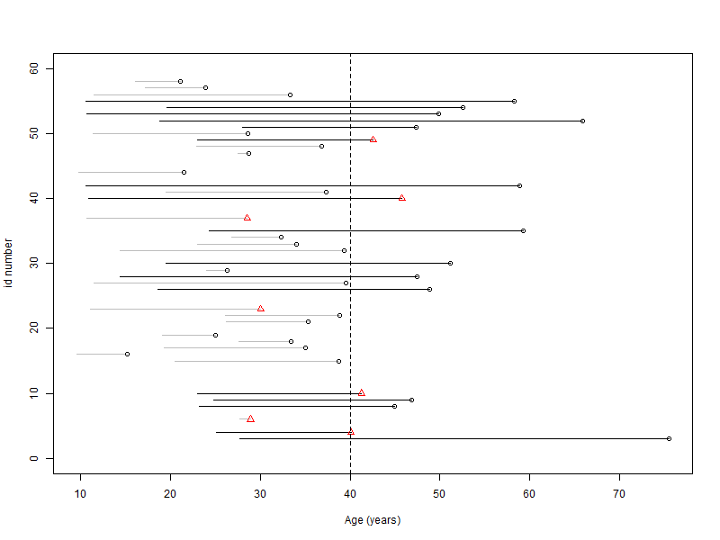
Time-scale

Slide 34
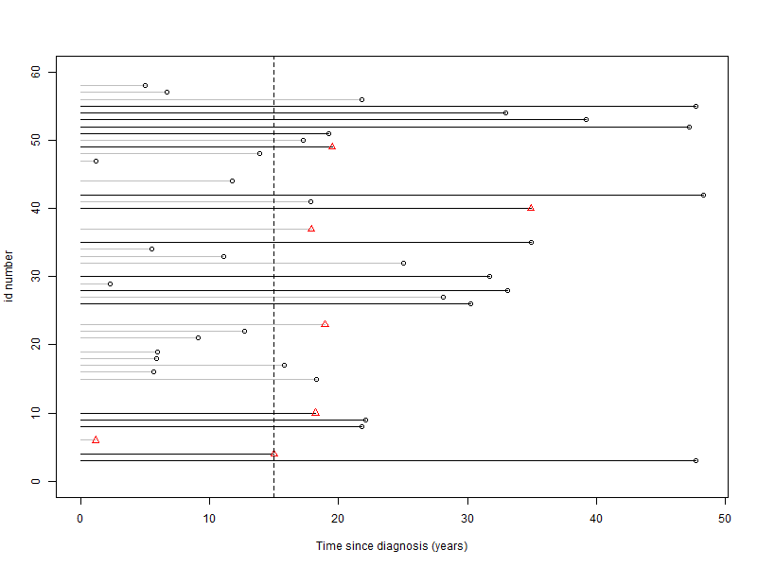
Time-scale

Slide 35
Confounding
  In contrast to RCTs confounding is expected (“always present”)
    (RCTs are of course also at risk of confounding)
  But exposure is NOT randomly assigned in observational studies
  Can be handled by stratification, matching, adjustment or weighting techniques (more about this tomorrow)

Slide 36
Nested case-control studies
Start with a cohort (e.g. the Danish population)
Identify all individuals with an outcome (the cases)
Controls selected by risk-set sampling
  Matching on important confounders
Typically used for rare outcomes
  More efficient since we do not need the whole cohort

Slide 37
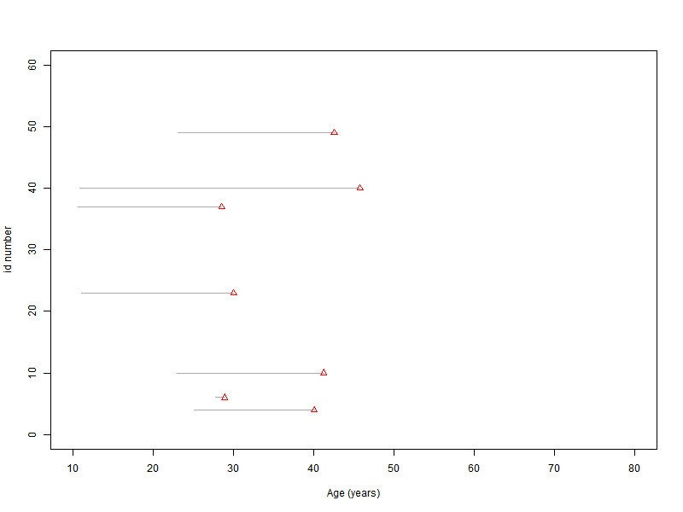
Nested case-control

Slide 38
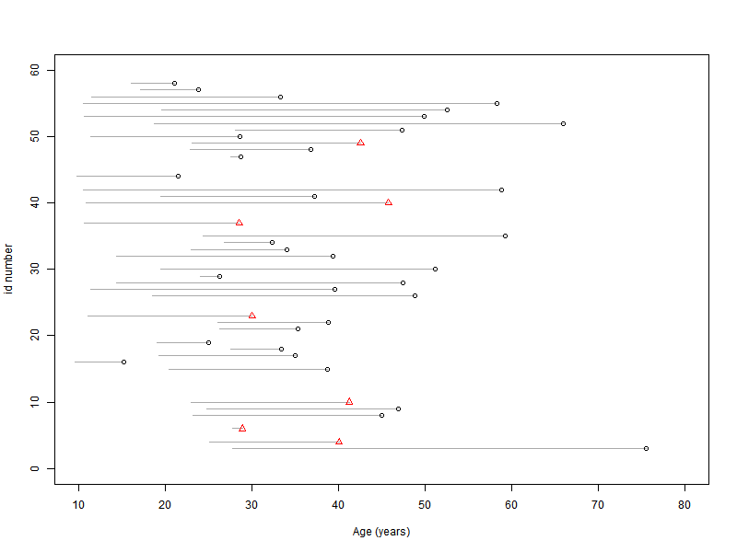
Nested case-control

Slide 39
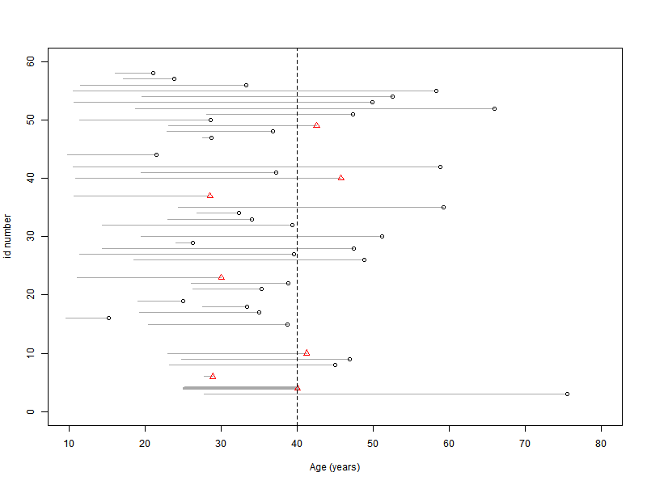
Nested case-control

Slide 40
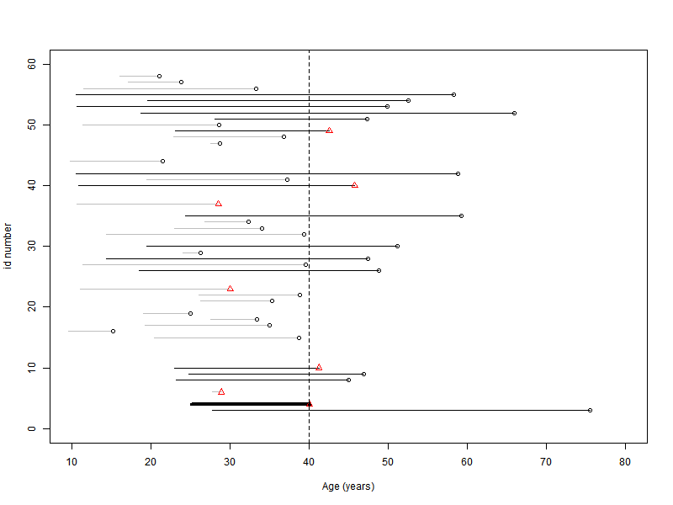
Nested case-control

Slide 41
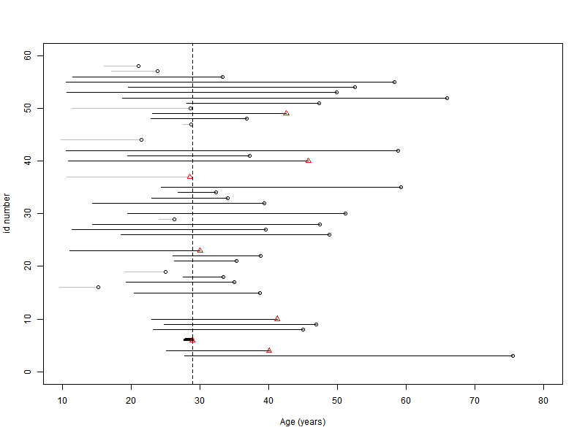
Nested case-control

Slide 42
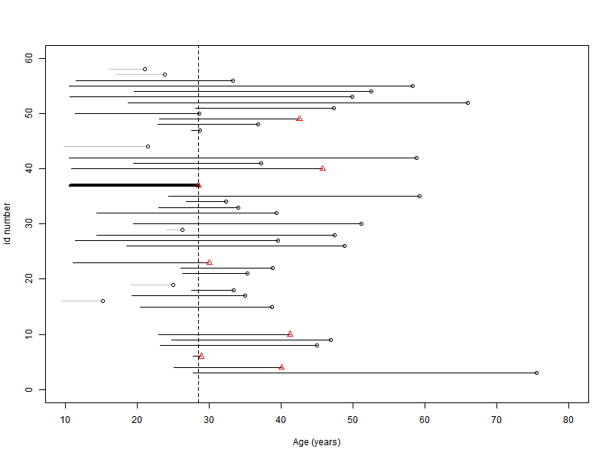
Nested case-control

Slide 43
Matching in cohort studies
Matching on exposure
  Different from case-control (matching on outcome)
Sometimes called cohort-cohort studies
Nomenclature is: exposed and unexposed (or comparison cohort)
Adjustment for matching factors

Slide 44
Matching in cohort studies

Slide 45
Other designs
  Case-cohort
  New-user
  Case-crossover
  Case-time-control
New and prevalent user designs tomorrow

Slide 46
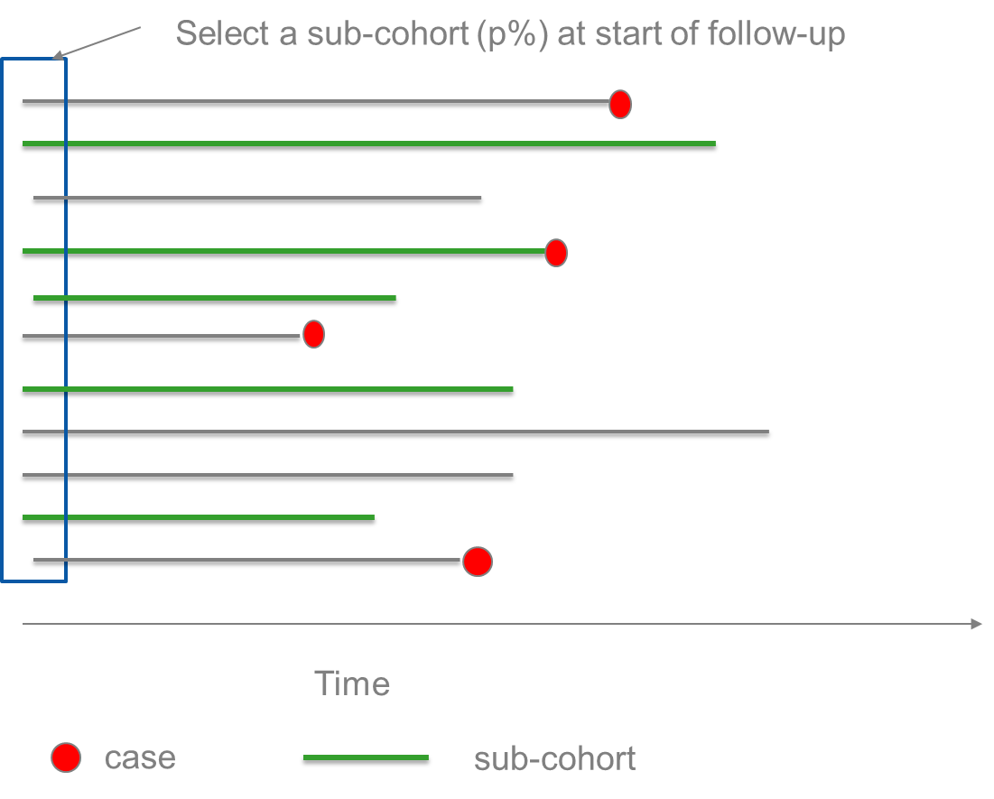
Case-cohort design
Slide by Elisabeth Wreford Andersen

Slide 47
Sampling of case-cohort
Cases
Sub-cohort
Select a sub-cohort at the start of follow-up (at random).
The sub-cohort will include some cases.
Also include all cases outside the sub-cohort (not random).
Final sample consists of sub-cohort+cases outside sub-cohort.
The same sub-cohort can be used for several diseases (cases)
Full cohort
Slide by Elisabeth Wreford Andersen

Slide 48
Case-cohort
  Can be used for multiple outcomes
    Main advantage compared to case-control
  Select a sub-cohort at start of follow-up
  Include all cases (for each outcome)
  Analysis needs to take oversampling of cases into account

Slide 49
Left truncation & new user design
P1
P2
P3
P4

Slide 50
New user design
  Using the prescription registry we have no knowledge about drug use prior to establishment of the registry (left truncation)
    Prior users in the non-user group (prevalent users)
    Treatment initiation is uncertain
      Duration and cumulative amount underestimated
  Leads to misclassification

Slide 51
New user design
How:
  Only consider new users
What:
  Remove persons with use in a predefined window just after the establishment of the registry

Slide 52
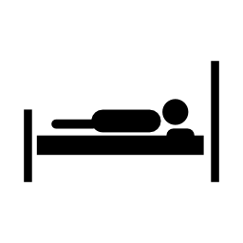
Case-crossover design
Proposed by Maclure (1991) to study transient effects on the risk of acute health events
Analysis like a matched case-control study
  But persons are their own controls (same person at different times vs. different persons at same time)
Within subject design
Exposed?
Exposed?
Health
event
Control period
Risk period

Slide 53
Exposure
Control period |  | Risk period
 |  | Exposed | Unexposed
 | Exposed | A | B
 | Unexposed | C | D
Only discordant pairs (B+C) enter the analysis
Chronic exposures not well suited – too many concordant pairs (A+D)

Slide 54
Things to consider
What is a relevant risk period (when is the risk altered)
Lag period between risk and control period?
How is the exposure defined
  Binary
  Continuous
Time-varying confounders?

Slide 55
Case-crossover
  Benefits
    Only cases considered
    Time-invariant confounding handled by design
    Less prone to confounding by indication
  Drawbacks
    Suitable only for acute effects and transient exposures
    Exposure rate constant over time
    Exposure effect and magnitude assumed constant

Slide 56
Case-time-control
  Also denoted case-control-crossover design
  Motivation: Address time-trend bias
  Start with a traditional case-control study
  Add crossover design to both cases and controls
  Adjust analysis for time trend in controls

Slide 57
Today’s most important design?
Outcome: Get your lunch at the canteen ☺
Done
5.S.B+C
Snack greens and cutlery
Warm dish
Salads
Plates
Reserved
tables
Water
Bread
5.S.A
Notes:
Motiver

